Slide 1
ELECTROMECHANICAL SYSTEM
Chapter 3: MOTOR CONTROL components

Slide 2
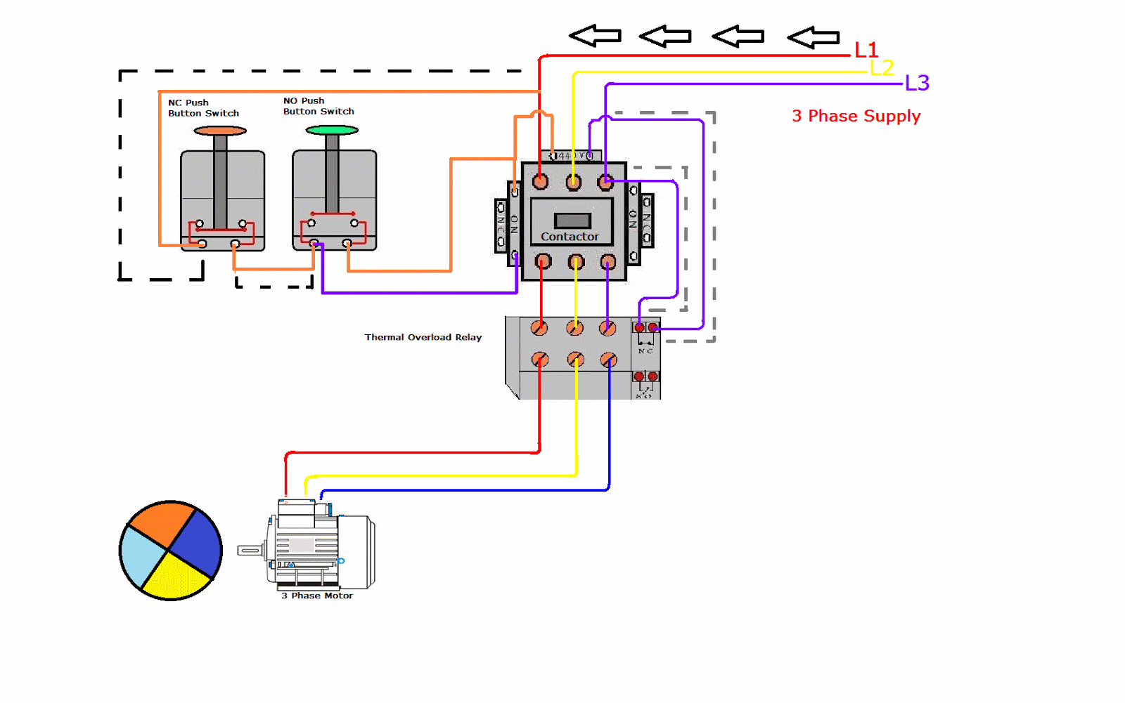
MOTOR CONTROL A motor control circuit can be defined as a means of supplying power to and removing power from a motor.

Slide 3
Basic Motor control components
CIRCUIT BREAKERS
FUSES
PUSH BUTTONS / SLDE SWITCHES/ TOGGLE SWITHES/ SELECTOR SWITCHES
INDICATOR LIGHTS
OVERLOAD RELAYS (THERMAL / SOLID STATE)
MAGNETIC CONTACTORS
CONTROL RELAYS
TIMERS
COUNTERS
8. MOTOR STARTER
9. AC/DC MOTOR
10. VARIABLE FREQUENCY DRIVE (VFD)

Slide 4
1. Circuit breakers
A circuit breaker is a switching device that interrupts the abnormal or fault current. It is a mechanical device that disturbs the flow of high magnitude (fault) current and in additions performs the function of a switch.
The circuit breaker is mainly designed for closing or opening of an electrical circuit, thus protects the electrical system from damage.

Slide 5
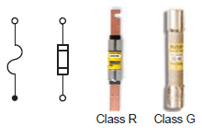
2. FUSES
AN ELECTRICAL SAFETY DEVICE THAT OPERATES TO PROVIDE OVERCURRENT PROTECTION OF AN ELECTRICAL CIRCUIT.
ITS ESSENTIAL COMPONENT IS A METAL WIRE OR STRIP THAT MELTS WHEN TOO MUCH CURRENT FLOWS THROUGH IT, THEREBY STOPPING OR INTERRUPTING THE CURRENT.

Slide 6
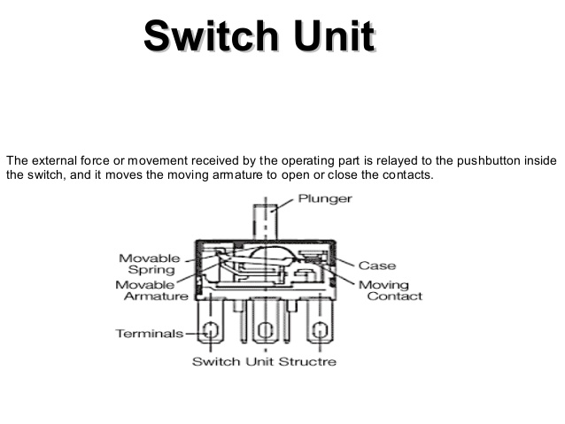
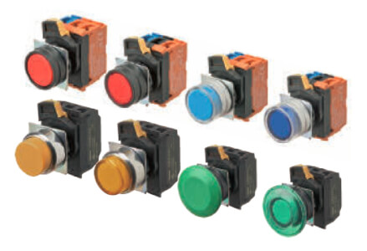
3. PUSH BUTTONS / SLiDE SWITCHES/ TOGGLE SWITHES/ SELECTOR SWITCHES
A CONTROL DEVICE USED TO MANUALLY OPEN AND CLOSE A SET OF CONTACTS.
TYPICALLY USES OPERATING PLUNGER, A RETURN SPRING AND ONE SET OF CONTACTS.

Slide 7
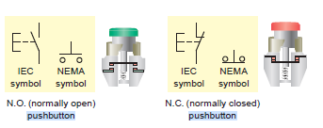
3. PUSH BUTTONS / TOGGLE SWITHES/ SELECTOR SWITCHES
MOMMENTARY PUSH BUTTONS – THEIR CONTACTS REMAIN IN THEIR ACTIVATED STATE ONLY AS LONG AS THE BUTTON IS PRESSED
MAINTAINED CONTACT PUSH BUTTONS – WITH CONTACTS THAT REMAIN IN THEIR ACTIVATED STATE AFTER THE BUTTON IS RELEASED

Slide 8
3. PUSH BUTTONS / TOGGLE SWITHES/ SELECTOR SWITCHES
A MANUALLY OPERATED SWITCH IS ONE THAT IS CONTROLLED BY HAND.
A TOGGLE SWITCH USES A MECHANICAL LEVER MECHANISM TO IMPLEMENT A POSITIVE SNAP ACTION FOR SWITCHING OF ELECTRICAL CONTACTS. THIS TYPE OF SWITCHING OR CONTACT ARRANGEMENT IS SPECIFIED BY THE APPROPRIATE ABBREVIATION AS FOLLOWS:
SPST—SINGLE POLE, SINGLE THROW
SPDT—SINGLE POLE, DOUBLE THROW
DPST—Double pole, single throw
DPDT—Double pole, double throw

Slide 9
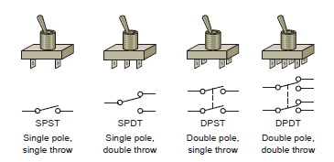
3. PUSH BUTTONS / SLDE SWITCHES/ TOGGLE SWITHES/ SELECTOR SWITCHES

Slide 10
3. PUSH BUTTONS / TOGGLE SWITHES/ SELECTOR SWITCHEs
ALSO USED TO MANUALLY OPEN AND CLOSE CONTACTS.
THE DIFFERENCE BETWEEN A PUSH BUTTON AND SELECTOR SWITCH IS THE OPERATOR MECHANISM. A SELECTOR SWITCH OPERATOR IS ROTATED (INSTEAD OF PUSHED) TO OPEN AND CLOSE CONTACTS OF THE ATTACHED CONTACT BLOCK.
AVAILABLE IN 2, 3, OR 4 POSITION TYPES.

Slide 11
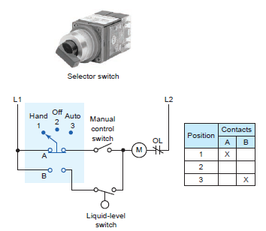
3. PUSH BUTTONS / TOGGLE SWITHES/ SELECTOR SWITCHES

Slide 12
4. INDICATOR LIGHTS (PILOT LIGHTS)
PROVIDE VISUAL INDICATION OF THE STATUS FOR MANY MOTOR-CONTROLLED PROCESSES PERMITTING PERSONNEL AT REMOTE LOCATIONS TO OBSERVE THE CURRENT STATE OF THE OPERATION.
THEY ARE COMMONLY USED TO INDICATE WHETHER OR NOT A MOTOR IS OPERATING.

Slide 13
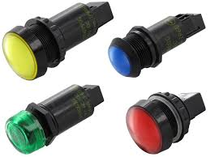
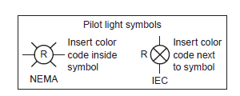
4. INDICATOR LIGHTS (PILOT LIGHTS)

Slide 14
5. OVERLOAD RELAYS (THERMAL / SOLID STATE)
USED TO PROTECT MOTORS FROM OVERHEATING.
WHEN EXCESSIVE CURRENT IS DRAWN FOR A PREDETERMINED AMOUNT OF CURRENT, THE OVERLOAD RELAY’S CONTACT S OPEN, REMOVING POWER FROM THE MOTOR.
AN OVERLOAD RELAY USED WITH A THREE PHASE MOTOR HAS 3 SUCH CONTACTS, ONE FOR EACH PHASE.

Slide 15
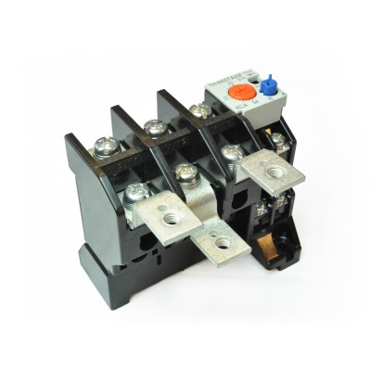
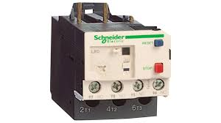
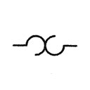
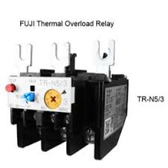
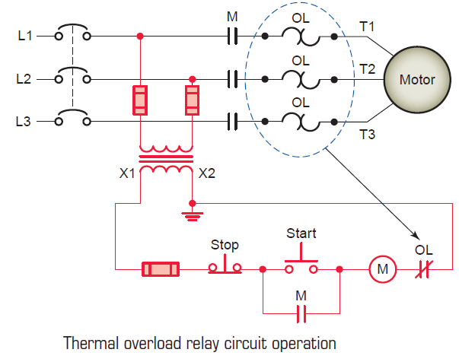
5. OVERLOAD RELAYS (THERMAL / SOLID STATE)

Slide 16
6. MAGNETIC CONTACTORS
CONTACTORS ARE USED IN CONJUNCTION WITH PILOT DEVICES TO AUTOMATICALLY CONTROL HIGH-CURRENT LOADS.
THE PILOT DEVICE, WITH LIMITED CURRENT HANDLING CAPACITY, IS USED TO CONTROL CURRENT TO THE CONTACTOR COIL, THE CONTACTS OF WHICH ARE USED TO SWITCH HEAVIER LOAD CURRENTS.
THE BASIC PARTS ARE ELECTROMAGNETS, SPRING, COIL AND CONTACTS

Slide 17
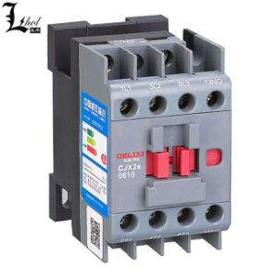
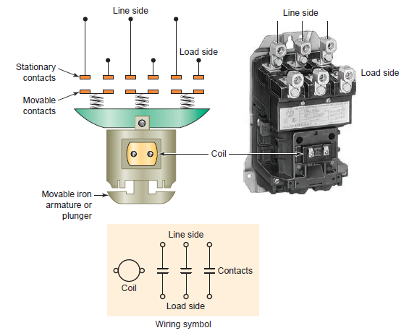
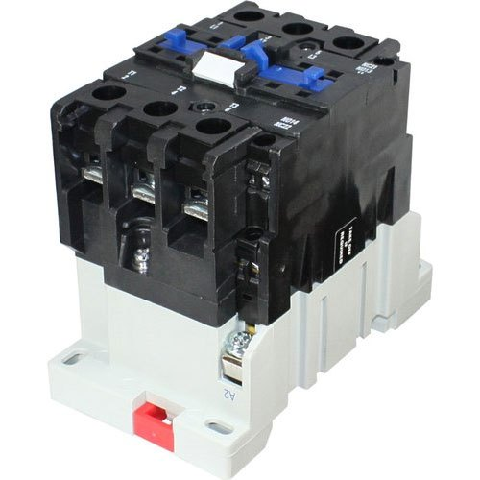
6. MAGNETIC CONTACTORS

Slide 18

6. MAGNETIC CONTACTORS

Slide 19
7. CONTROL RELAYS
RELAYS ARE ELECTRO0MECHANICAL SWITCHES THAT ARE TRIGGERED BY SUPPLYING ELECTRICITY THROUGH ITS COIL. WHEN THE RELAY COIL IS ENERGIZED, ITS CONTACTS WILL SWITCH TO ITS OPPOSITE STATE.
REMEMBER MAGNETIC CONTACTORS AND RELAYS ARE THE SAME.
CONTACTORS ARE FOR HIGHER LOADS AND RELAYS ARE FOR LIGHTER LOADS.

Slide 20
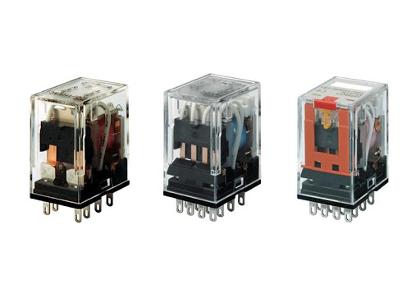
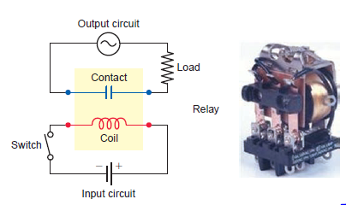
7. CONTROL RELAYS

Slide 21
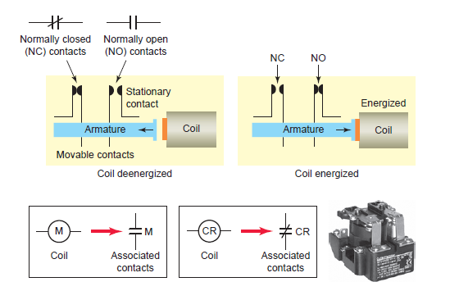
7. CONTROL RELAYS

Slide 22

7. CONTROL RELAYS

Slide 23
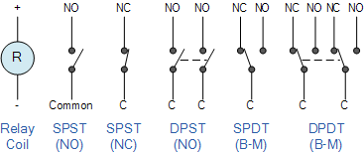
7. CONTROL RELAYS
Electrical Relay Contact Configurations
Where:
C is the Common terminal
NO is the Normally Open contact
NC is the Normally Closed contact

Slide 24
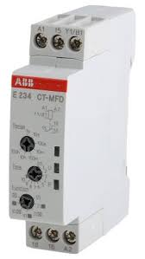
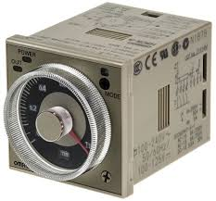
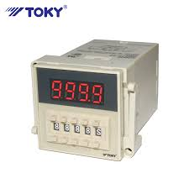
7. CONTROL RELAYS
TIMER RELAYS – TYPE OF RELAY THAT DELAYS THE SWITCHING OF ITS CONTACTS FOR AN ADJUSTABLE SPECIFIED TIME.

Slide 25
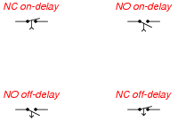
7. CONTROL RELAYS
TIMER RELAYS
CAN PERFORM EITHER ON-DELAY OR OFF-DELAY
ON-DELAY – INDICATES THAT A PRESET TIME MUST PASS AFTER THE TIMER RECEIVES A SIGNAL TO TURN ON BEFORE THE TIMER’S CONTACT CHANGE STATE.
OFF-DELAY – INDICATES THAT A PRESET TIME MUST PASS AFTER THE TIMER RECEIVES A SIGNAL TO TURN OFF BEFORE THE TIMER’S CONTACTS CHANGE STATE.

Slide 26
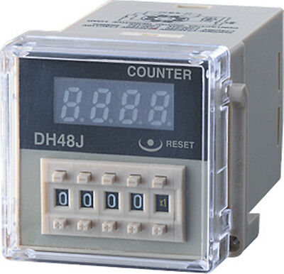
7. CONTROL RELAYS
COUNTERS – ELECTRO-MECHANICAL SWITCHES THAT ARE CAPABLE OF COUNTING AND STORING THE NUMBER OF OCCURENCES WHERE A PARTICULAR SIGNAL HAPPENS.
COUNTER RELAYS HAS 2 COILS THE COUNTING COIL AND THE RESET COIL AND A CONTACT.

Slide 27
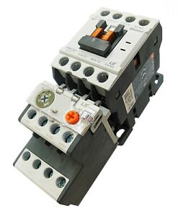


8. MOTOR STARTER
WHEN A CONTACTOR IS COMBINED WITH AN OVERLOAD RELAY.

Slide 28
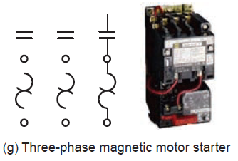
8. MOTOR STARTER

Slide 29
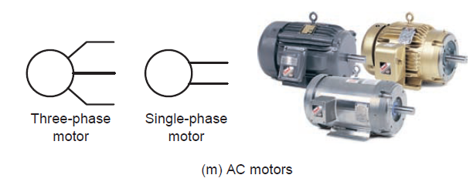
9. AC MOTORS

Slide 30
10. VARIABLE FREQUENCY DRIVE (VFD)
A VARIABLE-FREQUENCY DRIVECONTROLS THE SPEED OF AN AC MOTOR BY VARYING THE FREQUENCY SUPPLIED TO THE MOTOR.
THE DRIVE ALSO REGULATESTHE OUTPUT VOLTAGE IN PROPORTION TO THE OUTPUT FREQUENCY TO PROVIDE A RELATIVELY CONSTANT RATIO (VOLTS PERHERTZ;V/HZ) OF VOLTAGE TO FREQUENCY, AS REQUIRED BY THE CHARACTERISTICS OF THE AC MOTOR TO PRODUCE ADEQUATE TORQUE.

Slide 31
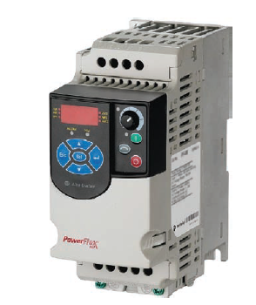
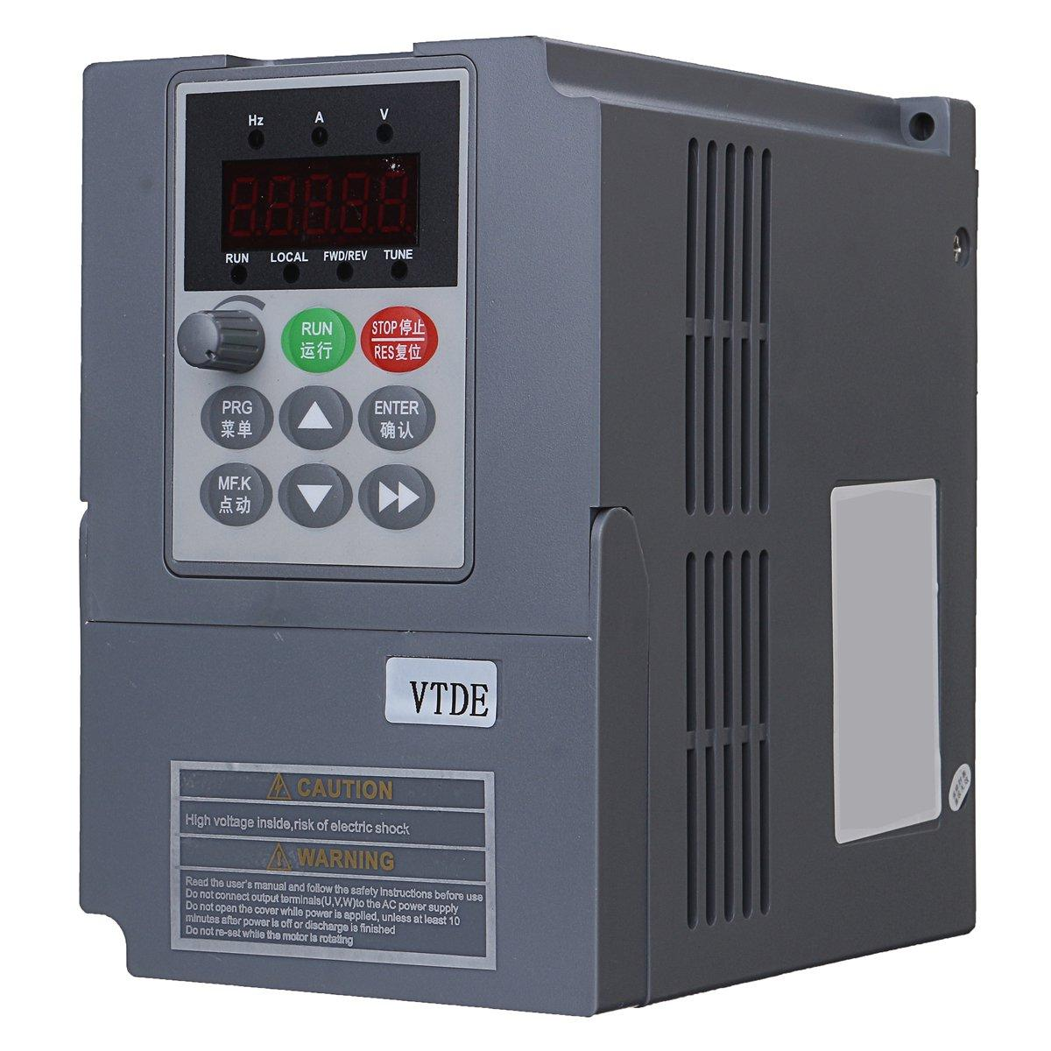
11. VARIABLE FREQUENCY DRIVE (VFD)

Slide 32
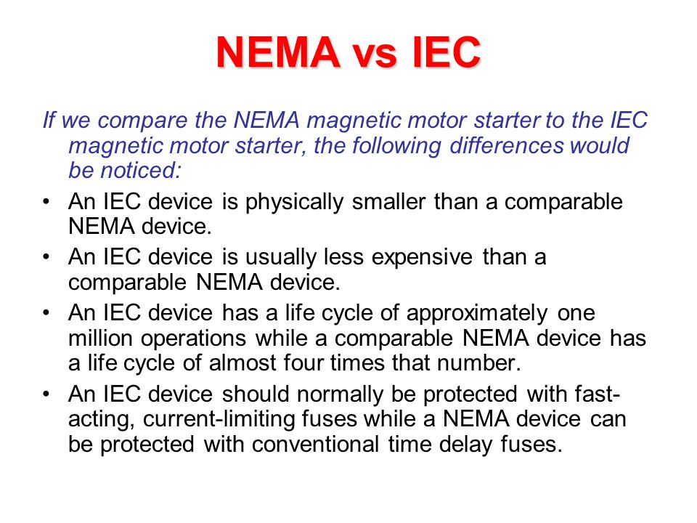

Slide 33
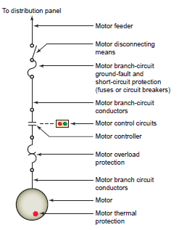
Electrical codes and standards
NATIONAL ELECTRICAL CODE (NEC)
Comprises a set of rules that, when properly applied, are intended to provide a safe installation of electrical wiring and equipment. This widely adopted minimum electrical safety standard has as its primary purpose “the practical safeguarding of persons and property from hazards arising from the use of electricity.”
The single-line diagram illustrates some of the motor terminology used throughout the Code and by motor control equipment manufacturers.
Remember: NEC provided the set of rules we are
using in designing and reading ladder diagrams
and single-line diagrams.

Slide 34
Electrical codes and standards
NATIONAL ELECTRICAL MANUFACTURERS ASSOCIATION (NEMA)
Based in North America, a group that defines and recommends safety standards for electrical equipment. Standards established by NEMA assist users in proper selection of industrial control equipment. As an example, NEMA standards provide practical information concerning the rating, testing, performance, and manufacture of motor control devices such as enclosures, contactors, and starters.

Slide 35
Electrical codes and standards
INTERNATIONAL ELECTROTECHNICAL COMMISSION (IEC)
The International Electrotechnical Commission (IEC) is a Europe-based organization made up of national committees from over 60 countries.
Dimensionally, IEC standards are expressed in metric units.
Like NEMA, IEC provides practical information concerning the rating, testing,
performance, and manufacture of motor control devices.

Slide 36
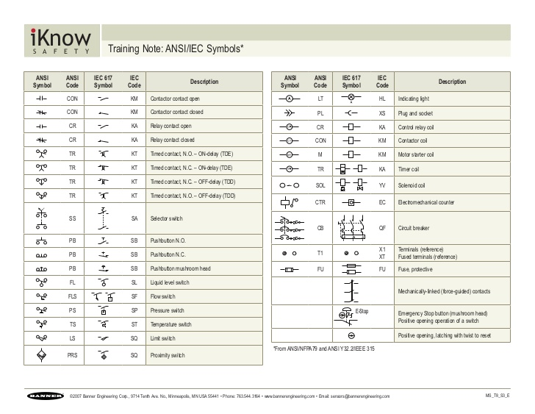
Source: https://www.slideshare.net/abok90/ms-t8-s3e

Slide 37
COMMON MOTOR CONTROL SYMBOLS
REFERENCE:
ELECTRIC MOTORS AND CONTROL SYSTEM, FRANK D. PETRUZELLA, pg .16

Slide 38
END of Chapter 3

